Slide 1
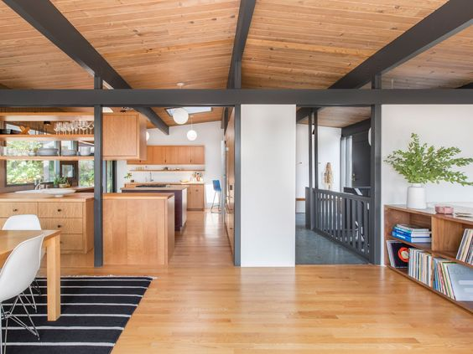
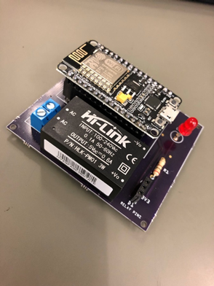
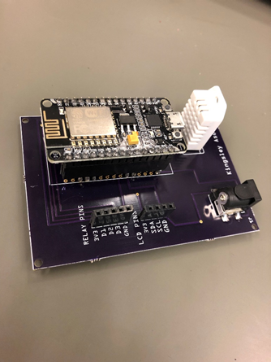
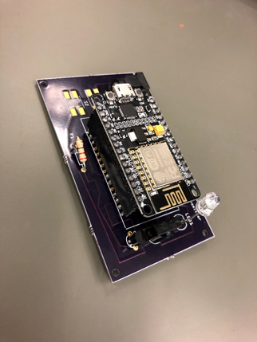
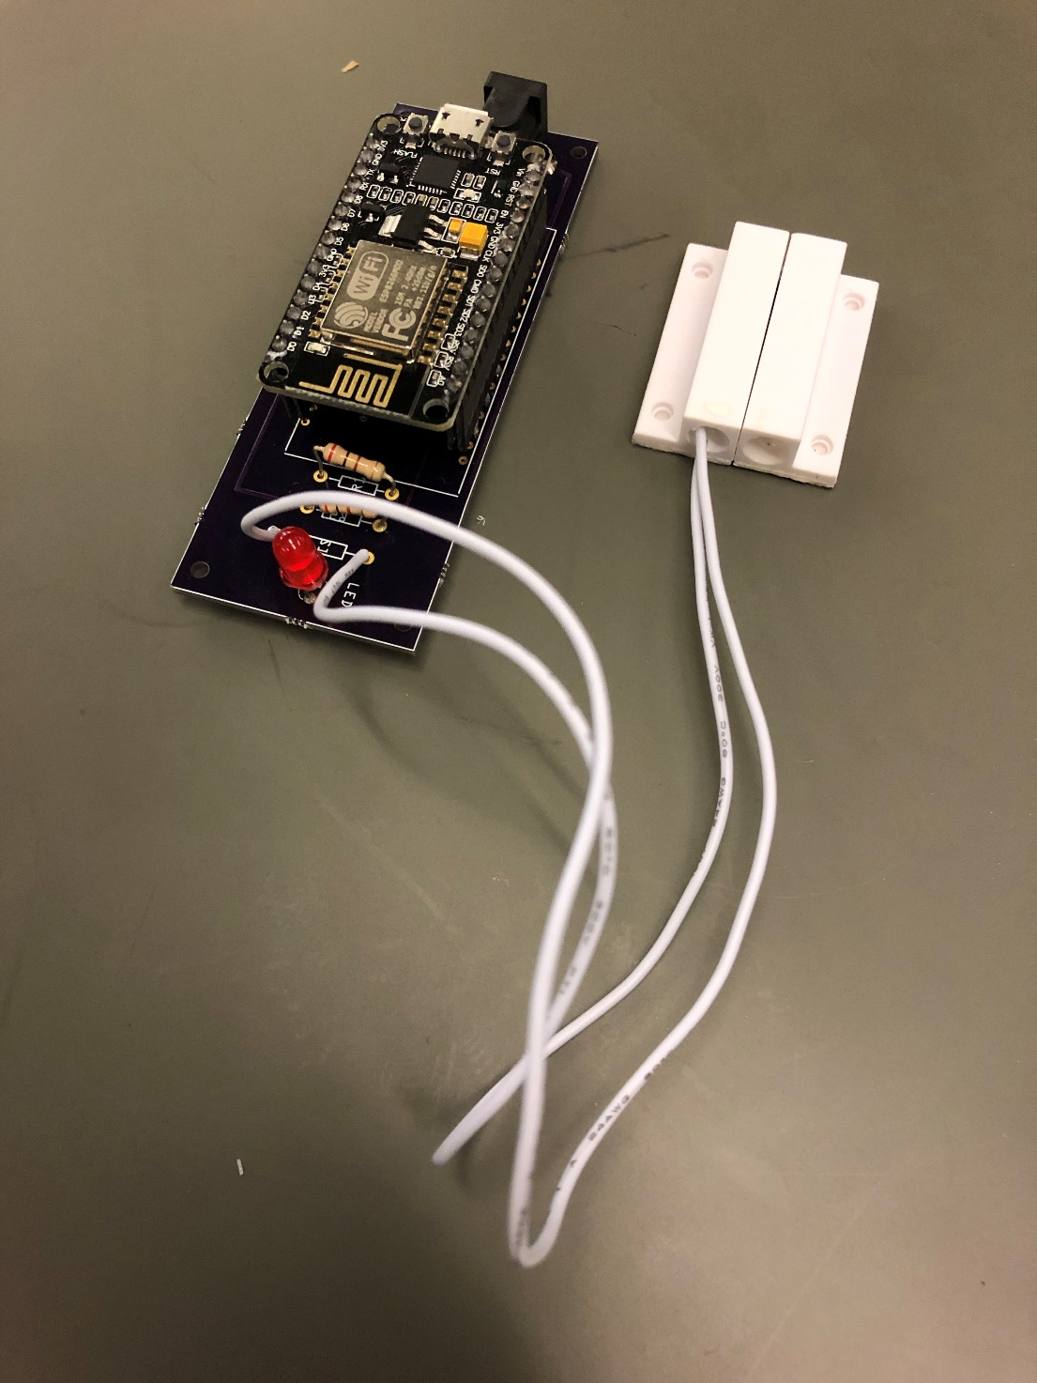

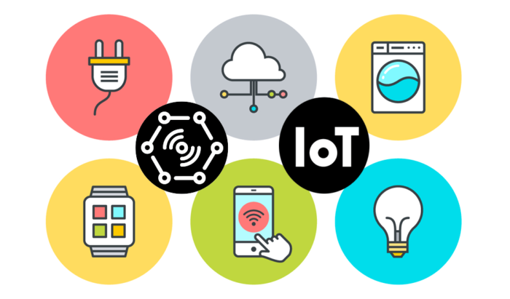
Developing Smart Home with Internet-of-Things Technologies
Light Control PCB
Temperature Control PCB
Television Control PCB
Door Sensor PCB
Speech recognition through Amazon Web Service (AWS).
Voice commands to appliances, such as TV, thermostats, etc.
User customized functions.
Open/Close Detection System
NDUBUISI IWUALA
KINGSLEY ASONYE
Room 1088
Easc building
may 13th , 2019
3:45 – 4:45 p.m.

